Slide 1
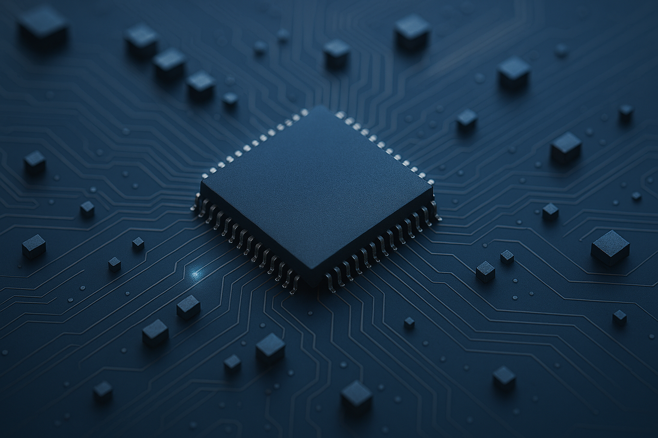

Embedded System Project (521423S)
Siva Ariram
Antti Tikanmäki
Marko Kauppinen
Jaakko Huikari

Slide 2
About the course
The goal of this course is to introduce students to the world of custom embedded computer systems.
Usually, participants are information and electrical engineering students who are familiar with software development and system design.
The Embedded System Project is related to but independent of Embedded Software Project (Sulautettujen ohjelmistojen projekti, 521275A) that concentrates on software-hardware interface.
A project-like assignment that requires approximately 120-160 hours from a team of three students.
This course is structured as a guided walkthrough of the hardware design process.
  Consists of the lectures and 7 meetings, either remotely or in person, with the assistant.
  One meeting after each design phase; The previous phase work is checked and the next phase discussed in each meeting.

Slide 3
About the course
In this course students:
Go through the complete design and implementation process of an embedded device
Do formal requirement specification and technical specification, write to a specification document
Select and order suitable components for the device
Create schematics, layout and manufacturing files for a PCB
Populate the PCB and test the board
Design and implement software for the device
Do formal testing to verify that the device fills the requirements
Write final documentation / report (in parallel, during the whole process)

Slide 4
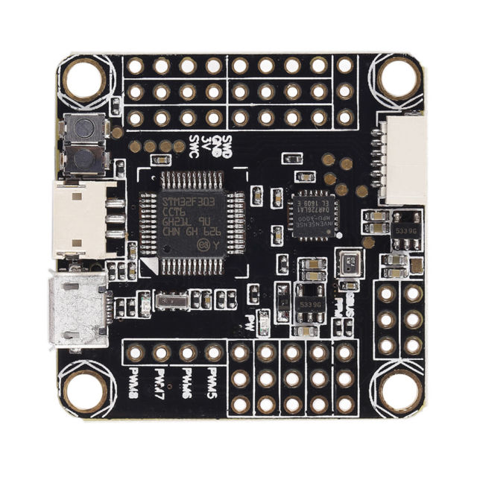
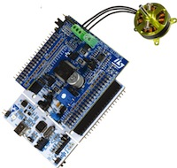
About the course:
In summary, in this course each group will make a prototype embedded device from start to finish:
Own custom board with microcontroller
  Requires some earlier HW development experience
OR
Extension board to a development board (for example, ESP32 or STM32 Nucleo)
  Aimed for less experienced & small groups
(Use of breakout board modules is allowed for some components that are difficult to solder / work on.)

Slide 5

Project phases

Slide 6
Design phases
In practice:
Requirement specification, Technical specification, test plan, Schedule
Schematics, component ordering
Layout and manufacturing files, PCB ordering
Populating the board and electrical testing
Programming software and testing
Final demonstration and Final report

Slide 7
Phase 1: Planning
Requirement specification
List of features
  Figure out what is the purpose and required functions of your device
Evaluating requirements (like storage, power, time of operation)
  For example: logging 10 hours of motor temperatures from 4 places, twice in a second to SD card
  -> You need to find system requirements for memory, storage, power usage, computational speed, size of the device,…
  You need to have a clear idea of the requirements when selecting, for example, a temperature sensor from thousands of options available from online sources
Use numbering and hierarchy in documentation:
  Req_1: User interface,
  Req_1.1: start button, stop button
  Req_2: Measuring temperature, params: 1 Hz, 1 digit, min -30, max 50

Slide 8
Phase 1: Planning
Technical specification
Determine the technical solution against requirement specification
Study application notes and component datasheets of potential components
  Only select components that are available well stocked and at a reasonable price
  Determine are they suitable for your application
  Try to find ones with easy to use & understandable built in functionalities, for example through UART, SPI, I2C, …
Try to use only one regulated voltage, like 5V or 3.3V if possible.
Do component comparison and final choices
Select a microcontroller / MCU development kit that contains suitable features (communication interfaces and others, such as DACs, ADCs, PWMs,…)
Preliminary calculations of IC related passive component values and requirements
Initial software specification (sketch the initial software structure, find out what libraries / tools can be used to make the implementation easier)

Slide 9
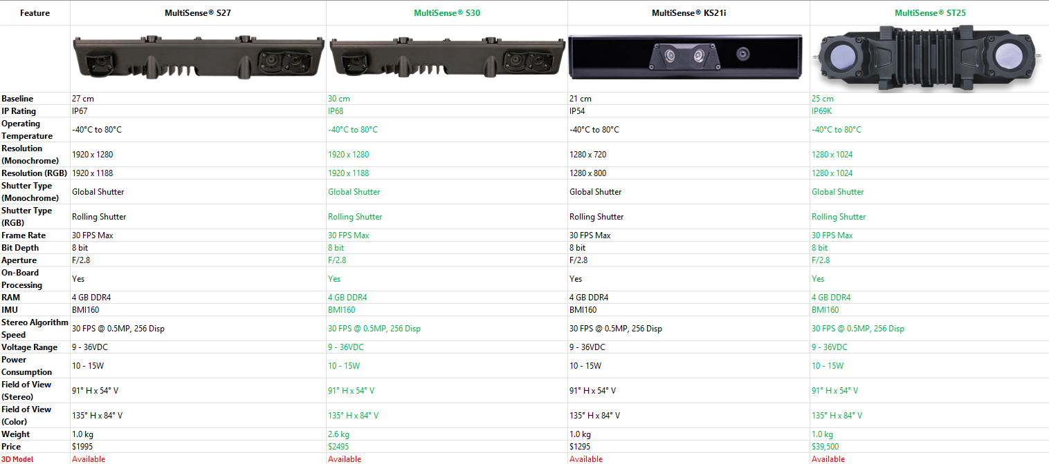
Phase 1: Planning(Tips)
Each Team will be assigned a project folder in Moodle.
Comparison Sheet

Slide 10
Phase 1: Planning
Test plan
  How to verify that each requirement is filled
    Calibration? Reference measurement?
    Example: temperature measurement with a reference device
  How to test that technical solutions works as expected
  If minimum and maximum requirement exist, how to measure in these conditions
Schedule
  Reserve weekly hours that you are able/will spend on this project
  Deadlines for each phase to complete project in time
    Define what needs to be done before DL
  Continuously update the log of used hours to learn how much time each job is taking in practice in the design process
  Keep your time schedule
    If schedule is missed, do rescheduling
  Report progress in phase meetings & keep documents up to date
    Agree suitable weekly/Biweekly meeting with your course assistant

Slide 11
Phase 2: Schematics & component use
Information sources for designing schematics:
The datasheets of the components
Study the related application notes
"typical application“ sections from the datasheets
Common practical schematic design considerations:
See how to regulate operating voltage
Find out how to use filtering / bypass capacitors
Find out what are pull-up and pull-down resistors
Don’t forget adding testing points (HW measurements with scope & other tools)
  https://openhardwaremonitor.org/
Never connect any output capable pin directly to the ground or power supply
Some tips:
Use comments on the schematics to clarify solutions
When technical specification is complete, group is allowed to order components
Use component order list provided in the course web page
Recommended schematics & PCB design tool:
KiCad https://www.kicad.org

Slide 12
Phase 3: Layout and manufacturing files, PCB ordering
Layout:
Aim for short tracks to avoid disturbances between tracks and other Electro Magnetic Interference (EMI)
You can use SMD components but choose components you are able to solder manually!
  If you are experienced enough, you may use the reflow / soldering oven. However, if you misuse the oven, it can destroy your board & components! (You wouldn’t bake the same pizza more than once either…)
Try to route your board with a principle that you use the top layer for vertical tracks and bottom layer for horizontal tracks. Or vice versa.
Clearance around important routes help debugging & fixing, if necessary
Place the filter / bypass capacitors of IC components as close as possible to the corresponding IC Vcc and Gnd pins.
Try to keep the supply voltage paths short to each IC from the regulators.
Choose the track width according the maximum current that goes through it.
Remember to add test pads / pins in easily usable locations
Connect any unused / extra copper areas of your board to ground

Slide 13
Phase 3: Layout and manufacturing files, PCB ordering
Manufacturing files:
After drawing a PCB layout, print it as a 1:1 size print and try if the components fit
Run Design Rule Check (DRC) against the given parameters
Plot and inspect PCB production Gerber files with KiCad
PCB ordering (when permission given by Assistant):
Manufacturing for free at the university’s PCB workshop
If you want to have multiples of your own boards to keep: Order from China for example from: http://imall.iteadstudio.com/open-pcb/pcb-prototyping.html
10 pieces 50x50mm at 9.90 $
  However, take in to account a long delivery time with the cheapest delivery options

Slide 14
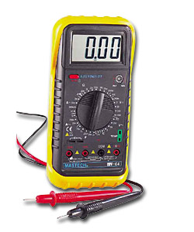
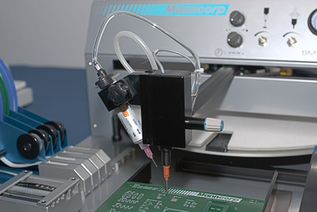
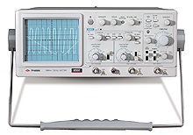
Phase 4: Populating the board and electrical testing
Hand operated SMD pick and place manipulator for populating the board in Fab Lab
For physical measurement of electrical features
  Oscilloscopes
  Multimeters
Measure all traces / soldered points to adjacent traces, grounds and supply voltages ensuring there are no shorts before connecting the power
  Multimeter resistance / continuity tester
For powering up the device
  DC power sources (use appropriate current limit initially to avoid total destruction)
Testing
  Work systematically
  Use scope to test the signals are what you expect
  To test some basic functionalities, write simple software routines

Slide 15
Phase 5: Software
Software design:
Develop the software parallel to hardware, write simple testing routines as early as possible for verifying that individual hardware components are working correctly
You may use C or C++, but other languages are allowed also if necessary
You may use open source libraries / functions to get the devices working
Plan SW timing, like how many times a second something needs to be done
Coding:
Split software to modules. For example SPI.c, I2C.c, X_sensor.c
Main.c should contain only high level function calls and the main loop
Design the use of interrupts and polling
Don’t write functions that are too long and / or convoluted
Study the common use of declarations in MCU coding, for example related to use of volatile keyword, pointers, etc. Proper use will help in debugging.
Study how global variables work and are used in practice (avoid data corruption)
Use best suitable variable types (unsinged or signed? 8,16 or 32 bits? Floats?)
Preferably use structs in function calls instead of many parameters (cleaner code)
You can measure your software timing in practice by using MCU outputs and scope

Slide 16
Tools section

Slide 17
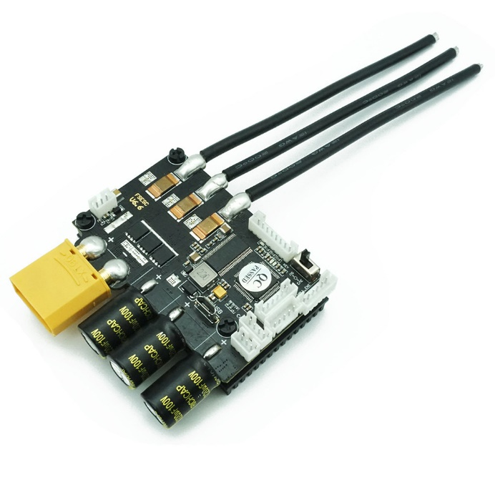
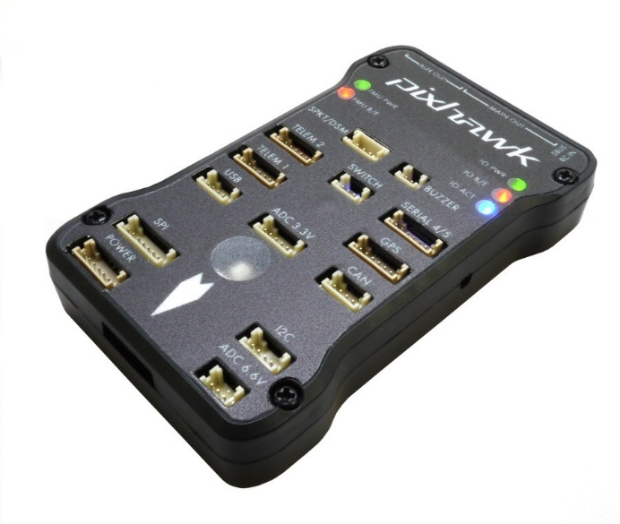
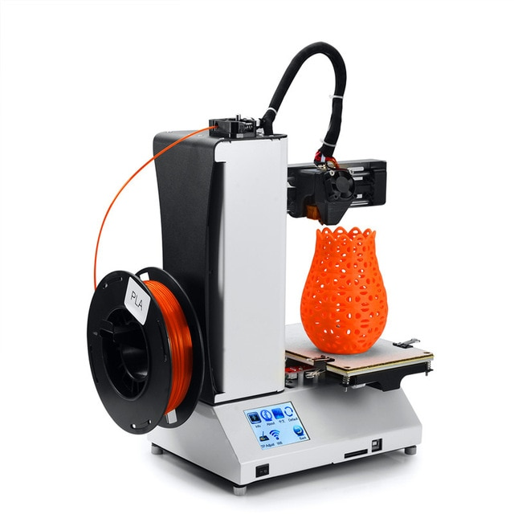
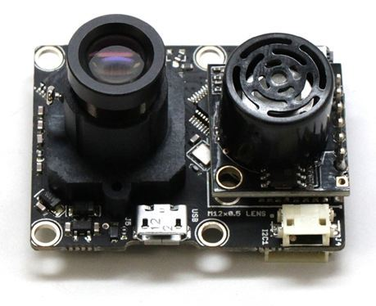
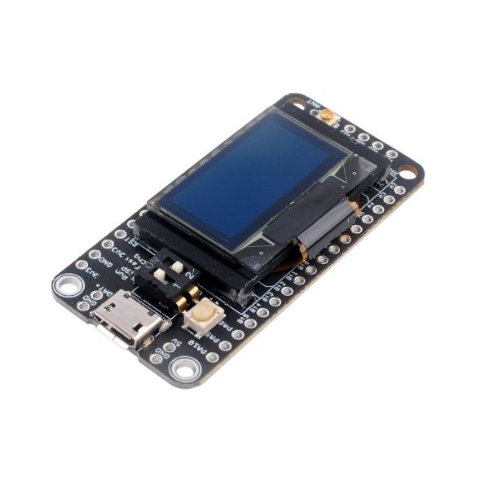

Examples of embedded devices
Brushless motor controllers
Drone flight controllers
Flow sensors
Gimbals
Smartwatches
Smart battery
3D printers
IoT devices
Etc.

Slide 18
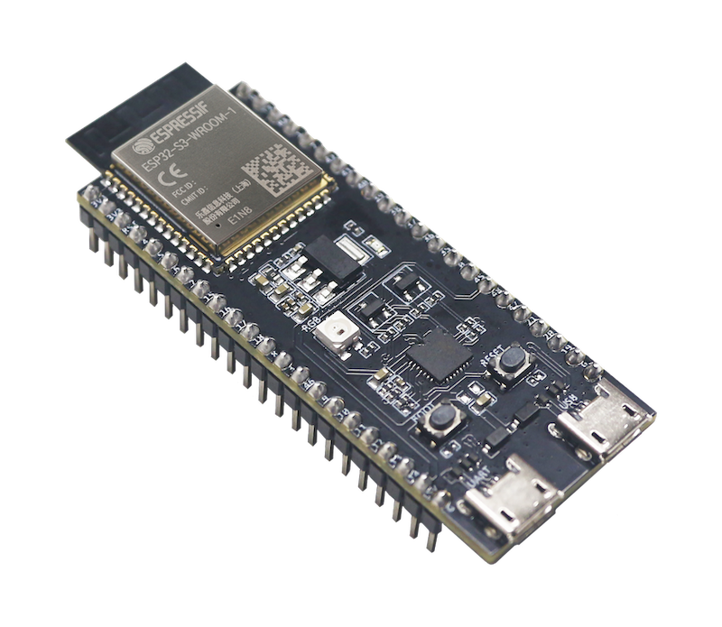
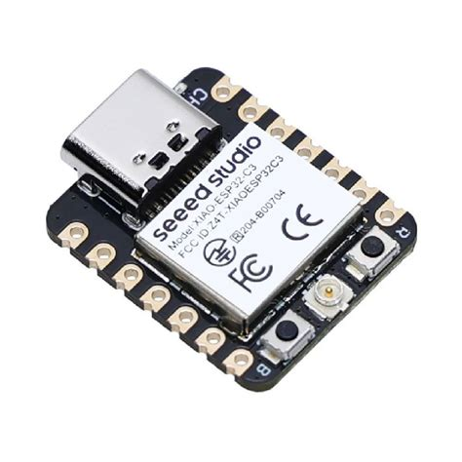
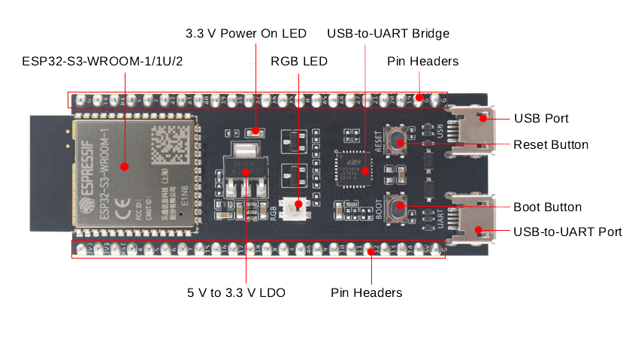
ESP32-S3
Options:
ESP32-S3-DevKitC-1
XIAO-ESP32S3
Programming
Arduino compatible
ESP-IDF

Slide 19
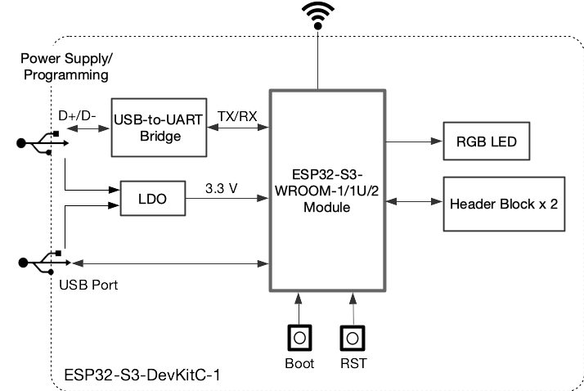
ESP32-S3-WROOM module

Slide 20
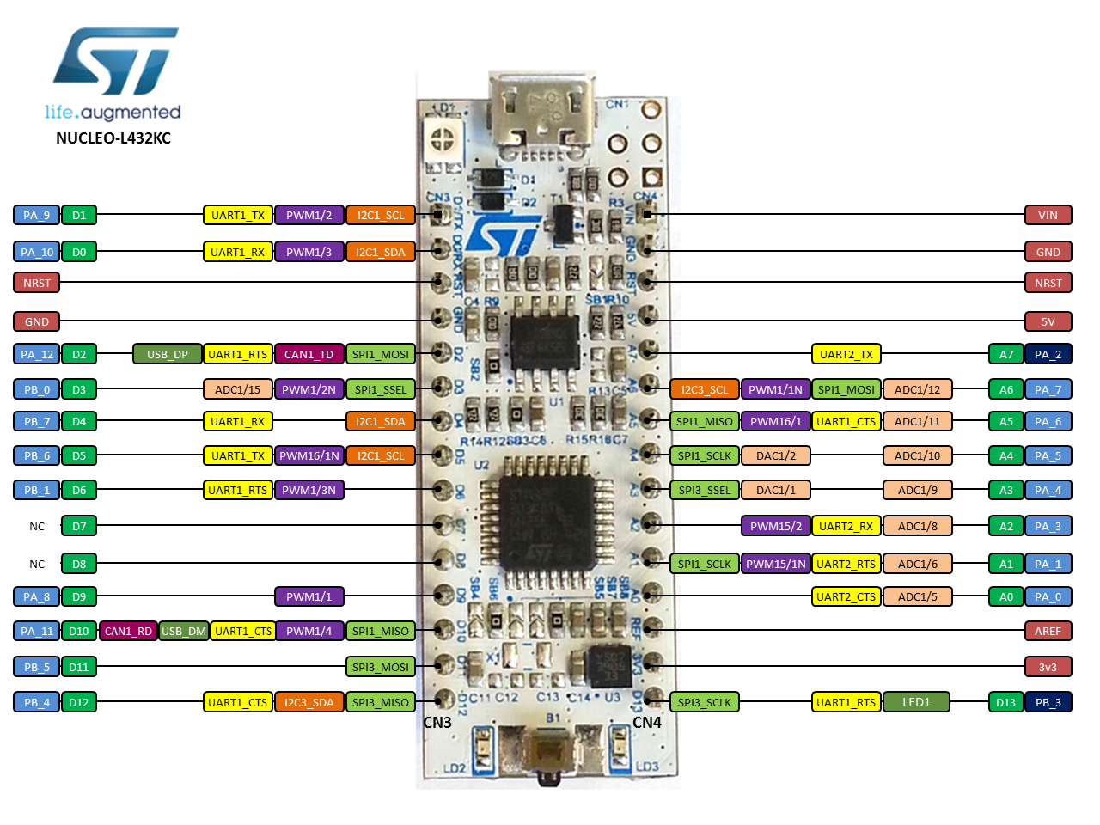
Nucleo example
STM32L432KC in UFQFPN32 package
ARM®32-bit Cortex®-M4 CPU
80 MHz max CPU frequency
VDD from 1.65 V to 3.6 V
256 KB Flash
64 KB SRAM
General Purpose Timers (4)
SPI/I2S (2)
I2C (2)
USART (2)
12-bit ADC with 10 channels (1)
GPIO (20) with external interrupt capability
RTC
Random Generator (TRNG for HW entropy)

Slide 21
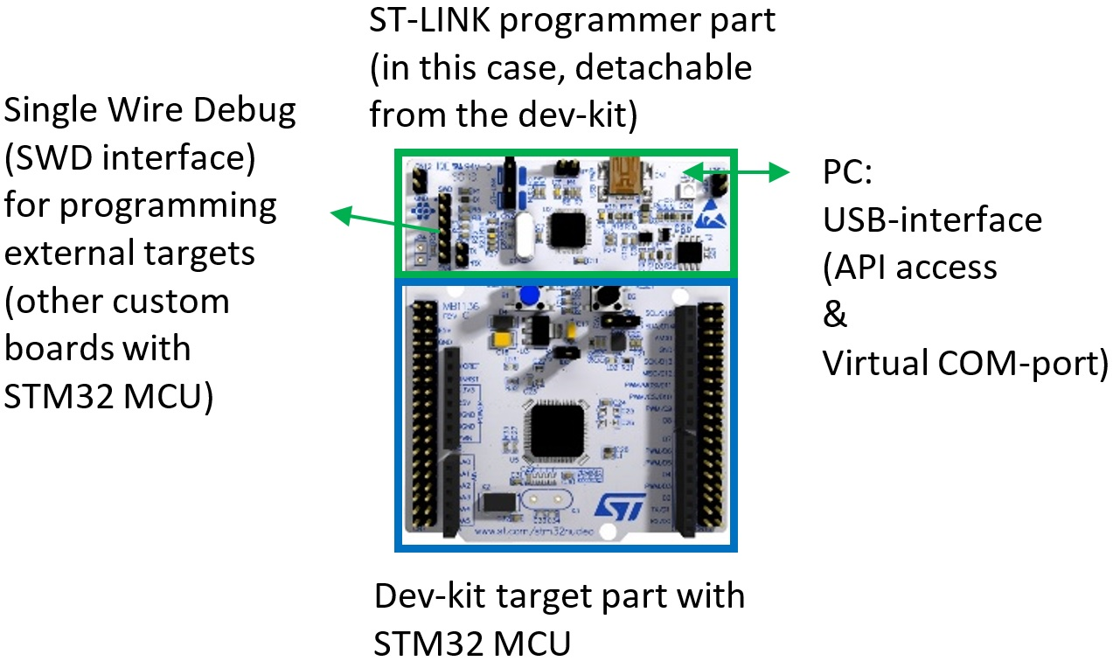
Tools: STM32 development boards
32-bit MCU
On-board ST-LINK/V2-1 debugger/programmer with USB re-enumeration capability: mass storage, Virtual COM port and debug port
Free compilers, C/C++ SDK, and developer community

Slide 22
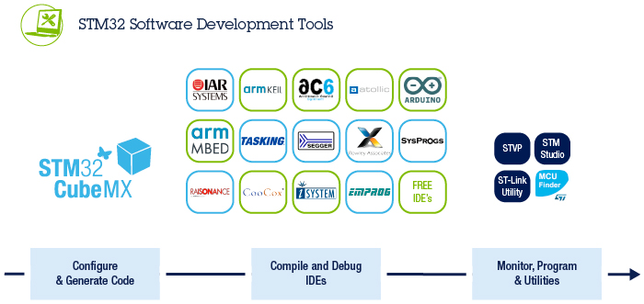
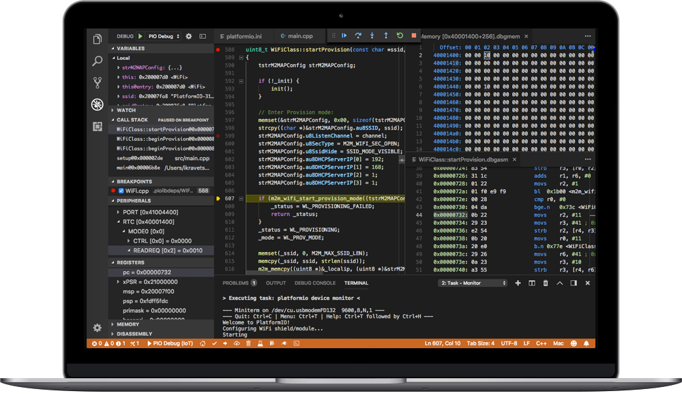
Development environments for STM32
STM32CubeMX graphical tool that allows a configuration of STM32 microcontrollers and the generation of the initialization C code through a step-by-step process.
STM32Cube-IDE (includes above, can be used with STM32CubeMonitor for debug)
Mbed IDE, online version require free registration
Arduino IDE, but make sure that the chosen MCU / devkit is fully supported, including debugging
OR:
Platformio.org Cross-platform IDE and unified debugger for Microsoft Visual Studio Code. Supports many dev boards and frameworks (STM32Cube, Mbed, Arduino)
  Command line tools available
  Libraries may not be the most recent!

Slide 23
Course procedure section

Slide 24
Course procedure
Name all your documents(Docs or pdf) with your group number
  Group1_Phase_1.pdf, etc.
All queries/discussion will be addressed through the Moodle discussion forum assigned to each group.
First face-to-face meeting should be in 2-3 weeks after the start. Otherwise, many students are tempted to delay their full commitment, resulting in large delays in completion.
Each group needs to send short report during each phase using Moodle forum containing progress and next things to do to prove that work is progressing as scheduled.

Slide 25
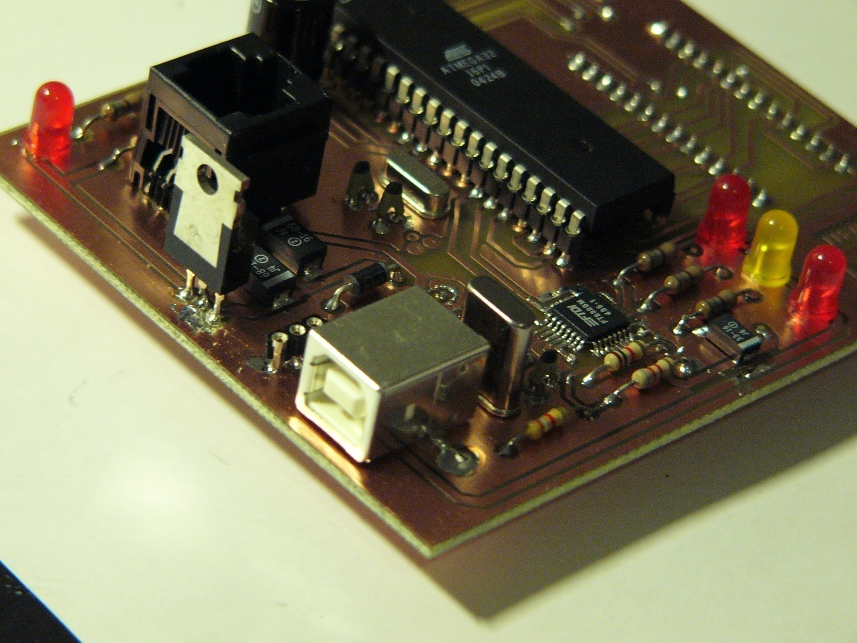
Course procedure
The assistant will have at least 7 scheduled 5–20-minute meetings with each group.
Send documents to be reviewed at least two day before the meeting
During the meetings the teams will describe their solutions, ideas and encountered problems, helping the assistant to correct serious design flaws at an early stage.
The meetings also encourage to the planned use of time, instead of painful around-the-clock marathons as the deadline approaches.
The contents of the meetings is as follows:
  Start meeting where topic is discussed and decided
  Inspection of requirement specification
  Inspection of implementation specification, and timetable. Advice on schematics and component list for students.
  Inspection of the schematics, component order list and inspection of refined specifications. Advice on layout for students.
  Inspection of layout printed in 1:1 scale. Footprint check and permission for manufacturing the PCB.
  Inspection of an assembled board. Advices for the testing of hardware and software.
  Demonstration of working board. Documentation and board left for grading.

Slide 26
Deliverables
Specification document containing
  Requirement specification
  Implementation specification
    Solution comparison
    Design parameters
  Test plan
Project plan
  Schedule
  log of work process
Schematic and layout of the PCB
Software
A prototype of the device and demonstration
Final report containing
  Device description
  User manual
  Test report
  Overall description of the implementation and future development
At the end, send all documents as zip file for complete review and grading

Slide 27
Grading
Grading is based on
Documentation (on each Phase) (Acceptable format: Docx or pdf)
Board design
  How well the given design guidelines are used
The sanity of the design (schematics check: pullups, filtering, hazardous connections)
Some jump wires will not affect to the grading. The students must be able to experiment.
The number of created board versions will not be considered, since it consumes so much time to make another iteration of a board.
Inspection against requirements
  Check each requirement
  Assessment of the stability of the system
Keeping of the schedule
Software only needs to be the minimum viable to demonstrate the functioning of your device against the requirements. Do not make the software in to a large project on the side!

Slide 28
~ Grading Matrix: left min., right max.
Documentation | Req. specification and final reports exist, but lack information and attention to detail. Design choices are reflected poorly against requirements for the project. Implementation specific details are lacking. | Requirements have been defined clearly, design and component choices are justified against requirements at some meaningful level. Describes the implementation sufficiently. | Design and component choices are reflected well theoretically against requirements. Implementation specifics and challenges encountered during development are described in great detail.
Hardware | The device has very little own circuit designs, and utilizes only a couple of breakout boards, or very little has been managed to get to work at some level. Has your own PCB as an extension / “shield” for a dev-kit. | Your PCB is an extension / “shield” for a dev-kit, and the board has at least some designed circuits on it. Can be mixed with some breakout boards. Some faults, but they are understood well what went wrong. | The MCU / MCU module, without dev-kit, is integrated on your PCB, and has significant own circuit designs. Has one or less breakout boards, and many sensors / ICs. Almost everything works as expected.
Code | Very little own coding and algorithm development. Documentation is lacking, but at least the device does something related to the requirements. | At least one own library / more complicated algorithm has been developed. Code has been structured & documented with enough clarity. Tries to fulfill most requirements. | Many own algorithms and / or libraries have been made. Code is clear and concisely documented. Device & code performs adequately or better against requirements.

Slide 29
Deadlines
22.01 Topic and Group (Moodle)
05.02 Phase 1 completed - Technical specifications and Test plan, Schedule
TBA Phase 2 completed - Schematics and component orders
TBA Phase 3 completed – Layout and manufacturing files, PCB ordering
TBA Phase 4 completed – Populating the board and electrical testing
TBA Phase 5 completed - Software
30.5. Phase 6 completed – All functionalities operating, Documentation ready

Slide 30
Lectures
4-5 times to give practical tips for each project phase:
- Specifications
- PCB design, Schematics, layout
- Software and testing
Each lecture contains short briefing lecture, and after that free discussion related to projects

Slide 31
Topics

Slide 32
About the topic
The basic requirements:
Suitable for people that are new to the embedded hardware.
Topics contains common technologies for which there are plenty of components and modules available
Assistants can be asked for help and to propose some suitable familiar resources / components, if there are difficulties navigating through the component selection process
Other features:
The teams are free to create additional features to their system if they will.
These additional features affect positively (to a certain extend) to the grading of the team
Own topics:
Primarily meant for more advanced students with some previous experience in embedded systems development
Students suggest a subject, assistants help refine it, and professor accepts it.
If you want the PCB after the course ends, you must buy the main components.
In addition to basic topic, some special research related topics may be available on course web page within few weeks after course start day

Slide 33
Topic 1: Activity / Health Monitoring Wristband
Requirements:
  A wrist wearable prototype device with some monitoring functionalities
  6-DoF IMU for activity monitoring (examples; intensity of movement during activity, sleep level detection, activity type: running, walking, etc.)
  Some other measurements (at least a couple; for example heart rate, temperature, relative blood pressure, …)
  UI on the wristband or / and remote UI on a PC / phone / tablet via BT, or Wi-Fi, or ...
Example of some possible optional features for more points:
  Some external inputs, for example a beacon to tell the wristband has reached a checkpoint, in a competition for example.
  Battery charger integrated (battery charge / management IC, to charge from USB, AC-DC adapter, wireless charger, etc.)
  Remote logging functionality
  Real time clock, calendar, memory card, GPS, something else...

Slide 34
Topic 2: Gaming console / system
Requirements:
  Some sort of UI / interface to represent the game
  Non-traditional control inputs, i.e. no joysticks / pads. Instead, use non-traditional control inputs, for example based on motion information from IMU, gesture sensor, voice, camera for face recognition, breathalyzer, whatever you can come up with
  Battery level indicator
  Sound generation
Example optional features for some extra points:
  The more sensors used, and the more intriguing the system, the more points
  A multiplayer option
  Haptic feedback
  Wireless communication with a PC, phone, tablet
  USB / Wireless battery charger
  Some unimaginable extra feature, you decide.

Slide 35
Topic 3: Drone Orientation & Stability monitoring module
Requirements:
A small embedded prototype for monitoring drone orientation and stability.
6-DoF or 9-DoF IMU for attitude estimation (pitch, roll, yaw).
Motor RPM measurement or vibration determination at 1 kHz or faster, or data logging capability.
Use of a filter or other method in orientation calculations to combat drift and inaccuracy (e.g., Kalman filter, complementary filter).
UI on a small display or remote UI on PC/mobile via Bluetooth or Wi-Fi.
Example optional features for some extra points:
External input: GPS beacon for position tracking.
Battery charger integrated (Li-Po charging IC, USB-C input).
Remote logging functionality for flight data.
Real-time clock, SD card storage, telemetry over LoRa or Wi-Fi.

Slide 36
Topic 4: Smart Battery Management System for Drones
Requirements:
A prototype for monitoring and managing Li-Po batteries with 3 cells or more.
Measurements: voltage, current, temperature.
Accurate State-of-Charge (SoC) estimation under load, considering temperature effects (since this is non-trivial for Li-Po batteries).
Display battery status locally or via remote UI.
Overcharge/discharge protection circuit.
Example optional features for some extra points:
Wireless data transmission (Bluetooth/Wi-Fi).
Predictive battery life estimation using simple algorithms.
Integration with drone flight controller for emergency landing alerts.

Slide 37
Topic 5: Own topic
Area of your own interest:
  Communication
  Biomedical
  Electronics
Can be proposed to assistants, may be accepted if challenging enough
Requires good specification so that it can be understood easily what is planned to be implemented and how
Some initial research & calculations about the physics / other aspects involved that will determine requirements for components
Assistants may not be able to help as well as in the other two topics, if the topic is not familiar for the assistants.

Slide 38
Finally some important advice
Do not delay your start.
  We recommend that this course is taken only when the team has the intention and dedication (and enough time) to complete the assignment during the fall semester.
Keep notes, documentation is your best note
and testing functions (SW)
In addition, the students have commented that ‘low intensity’ projects result in much more working hours than necessary.
Work systematically:
  Figure out first: what is the purpose and required functions of your device?
  Split it to smaller parts and define requirements numerically
    For example: required measuring range and resolution
  Find technical (HW or/and SW) solution to the requirements
  (simulate), implement and test
When developing the device
  Do not rush, Be careful, systematic and thorough, follow instructions
  When you get stuck, find help from
    datasheets and manuals
    Google
    course web pages
    Assistants
Moodle page: Embedded System Project 521423S-3006

